Slide 1
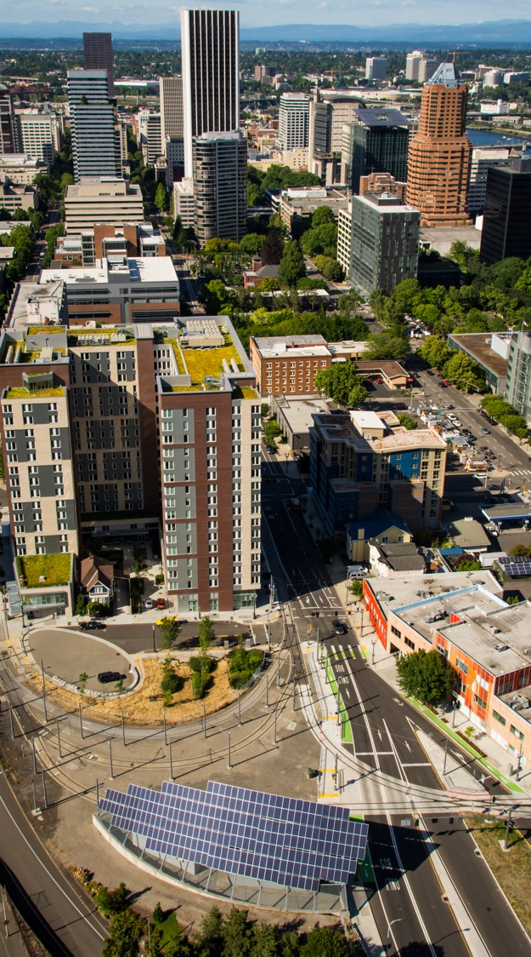
COVID-19 and Shootings ARPA Grant
Preliminary visual results
Nick Kobel
Analyst
Notes:
Friday~!

Slide 2
PURPOSE Identify areas that have a high correlation among key indicators, including - Shootings - COVID-19 infections - Equity and vulnerability - Neighborhood completeness
Notes:
Our 6/3 conversation left me with task to identify the parts of town with a high degree of association between key variables. The variables are shown here. Today’s briefing is to show some early results of that analysis, with the intention to use these results on the ARPA grant application.
We also discussed looking at co-location with homeless camps, since approximately 40% of shootings that occurred were transient-involved. However, not enough time was available to acquire and understand the homeless camp data, nor perform spatial statistical analysis of point-level data.

Slide 3
Research design
Unit of analysis: Census tracts
Assign all data to the census tract geographic level
Perform analysis on attributes of each tract

Slide 4
Single-variable Maps
Notes:
5 maps to show you with a single variable each

Slide 5
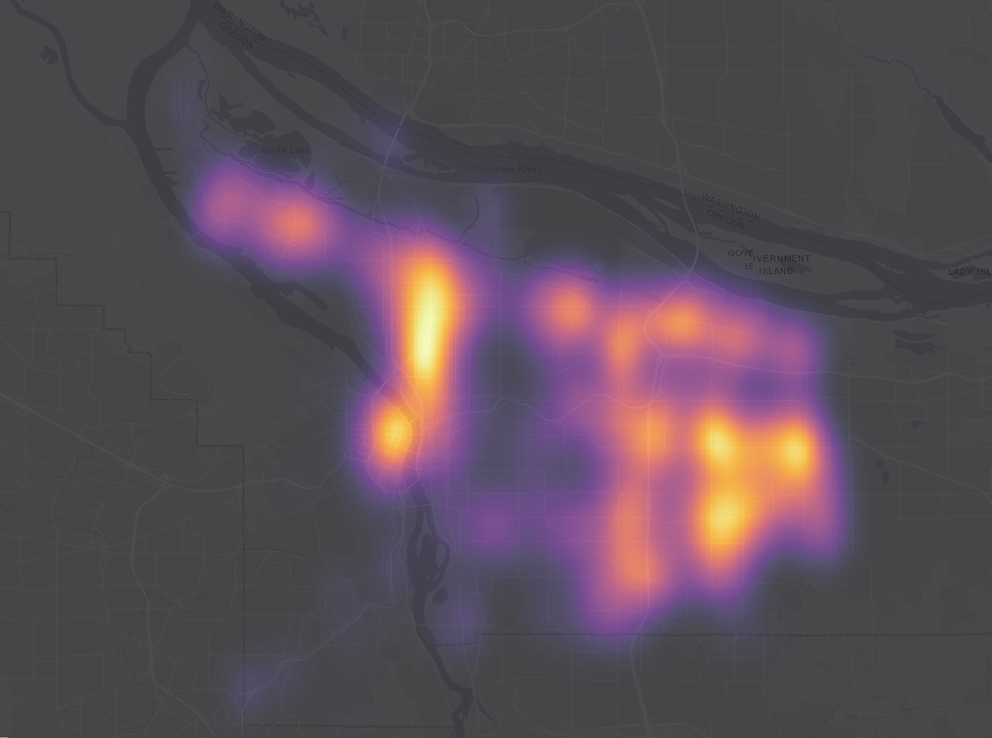
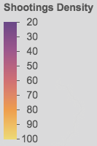
Shootings
Notes:
These are shootings after 5/20/2020. Shooting rate per 100,000.
Takeaway: East Portland cluster, downtown, and MLK corridor are hot sots.

Slide 6
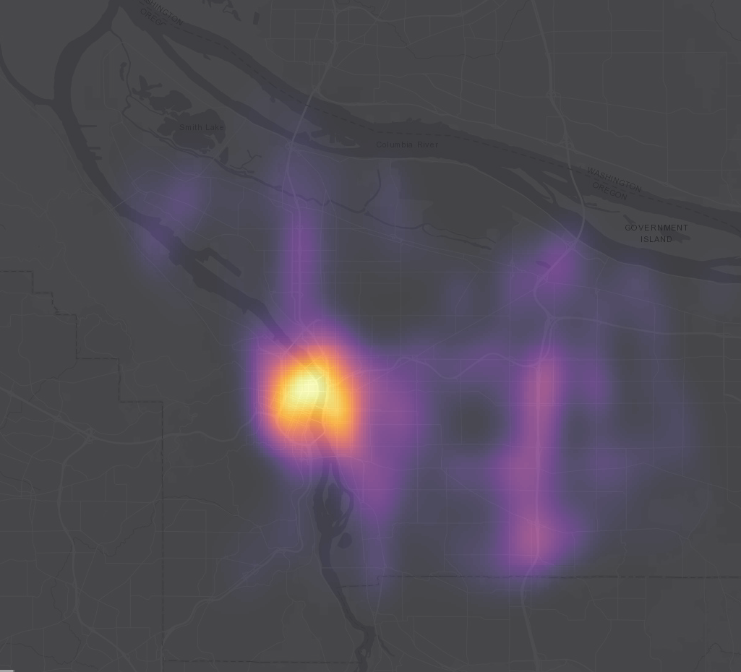
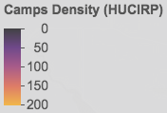
Urban Camps
Notes:
Takeaway: Cluster in Central City and along I-205 and I-5 corridors
Homelessness and Urban Camping Impact Reduction Program
https://www.portlandoregon.gov/toolkit/article/562211

Slide 7
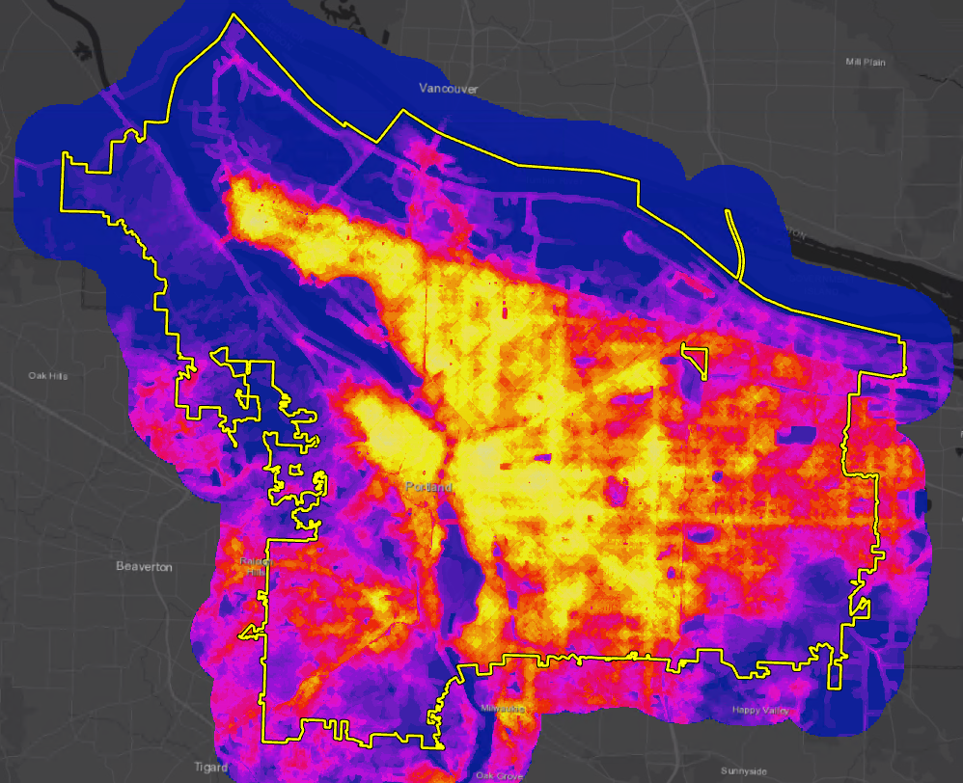
Complete Neighborhood Score
Food access
Schools
Transit access
Commercial services
Parks access
Pedestrian infrastructure
Bicycle network
Notes:
Neighborhood Completeness – a measurement of the built environment, sort of like a walk score, but much more thorough: CLICK
Food access (grocery store, ethnic food markets)
Schools
Transit access
Commercial services (i.e., hardware, pharmacy; need-to-have’s and want-to-have’s)
Parks access
Pedestrian infrastructure (sidewalks, curb ramps, street connectivity)
Bicycle network
Takeaway: Areas outside the Central City and inner neighborhoods are the least complete

Slide 8
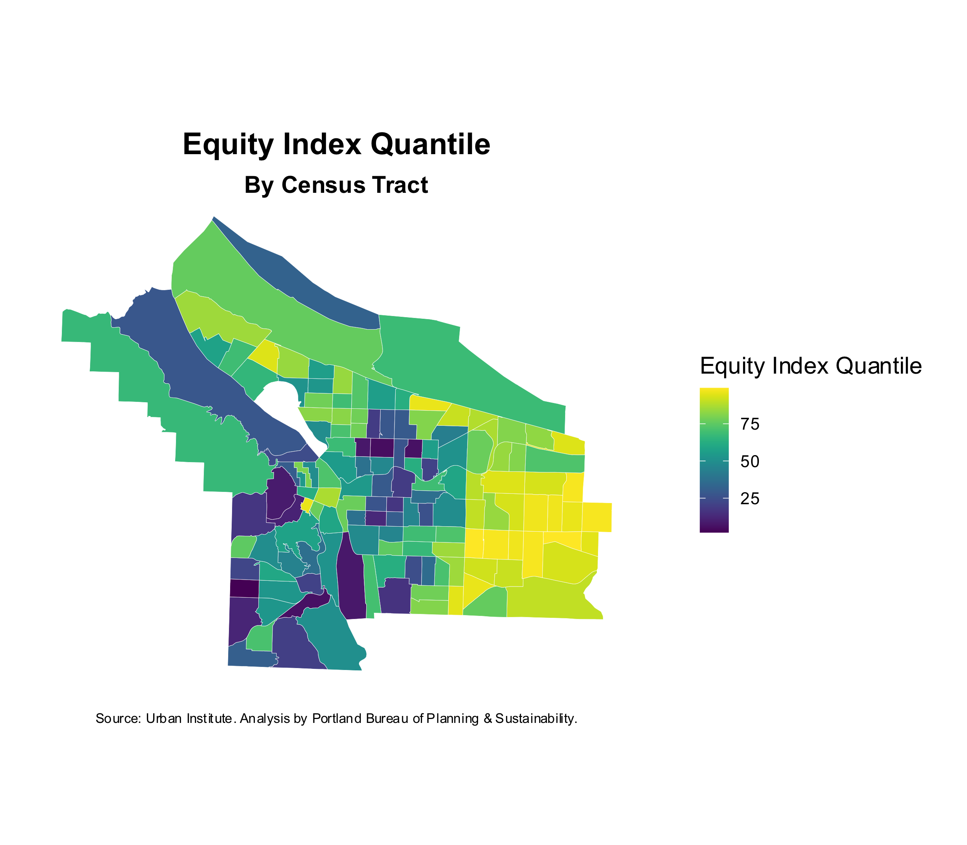
Equity Index
Equity Index =
BIPOC (50% weight)
Extremely low income
Public assistance
Foreign-born population
Notes:
Equity index here is not BPS’ vulnerability index, but it’s similar. Using Urban Institute’s equity index for their emergency rental assistance prioritization work. The equity component includes people of color, ELI households, households on public assistance and the foreign-born population. It’s weighted primarily by BIPOC (50%).
Takeaway: East Portland, North Portland and downtown rank highest on this index

Slide 9
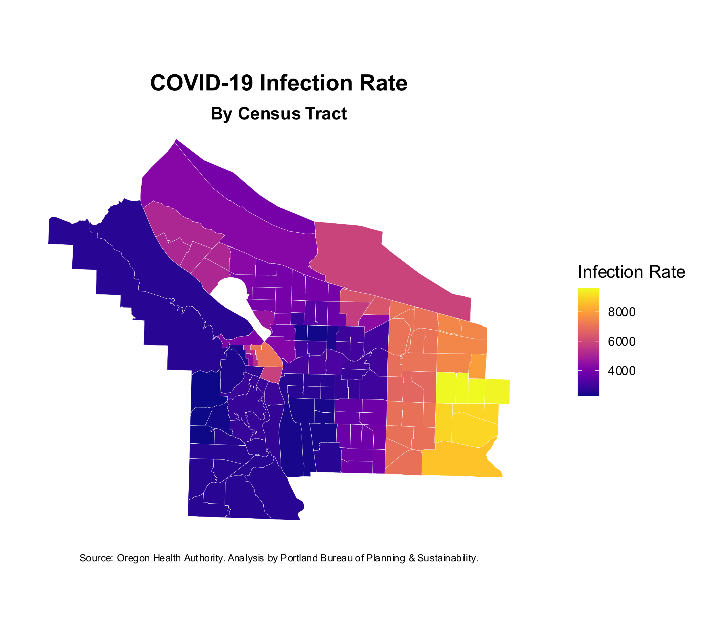
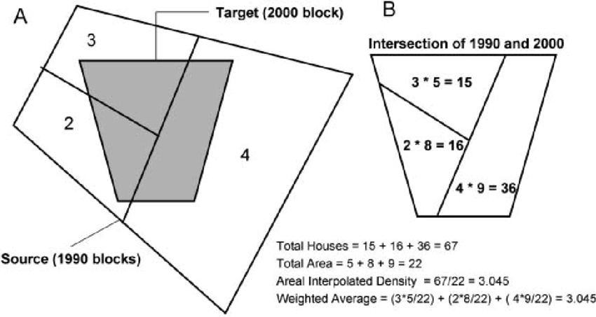
COVID-19 Infection Rate
Notes:
This tract-level data was derived from ZIP code-level estimates using areal weighting.
Infection rate per 100,000.
Takeaway: Outer East Portland is the hardest hit.

Slide 10
Charts

Slide 11
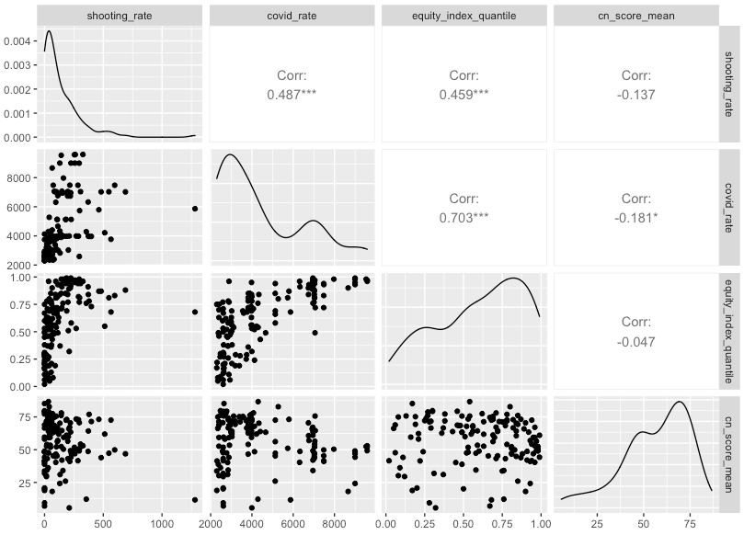
Shooting rate
COVID-19 rate
Equity index
CN score
Correlation Matrix
Shooting rate
COVID-19 rate
Equity index
Complete Neighborhood score
Notes:
Are these indicators correlated?
How are they correlated? What magnitude and direction?
Is the correlation significant?
Correlation is not causation. A might cause B… or C might cause both A and B… or B might cause A
Takeaway: As suspected, these variables are all moderately correlated to one another; the correlation is statistically significant.

Slide 12
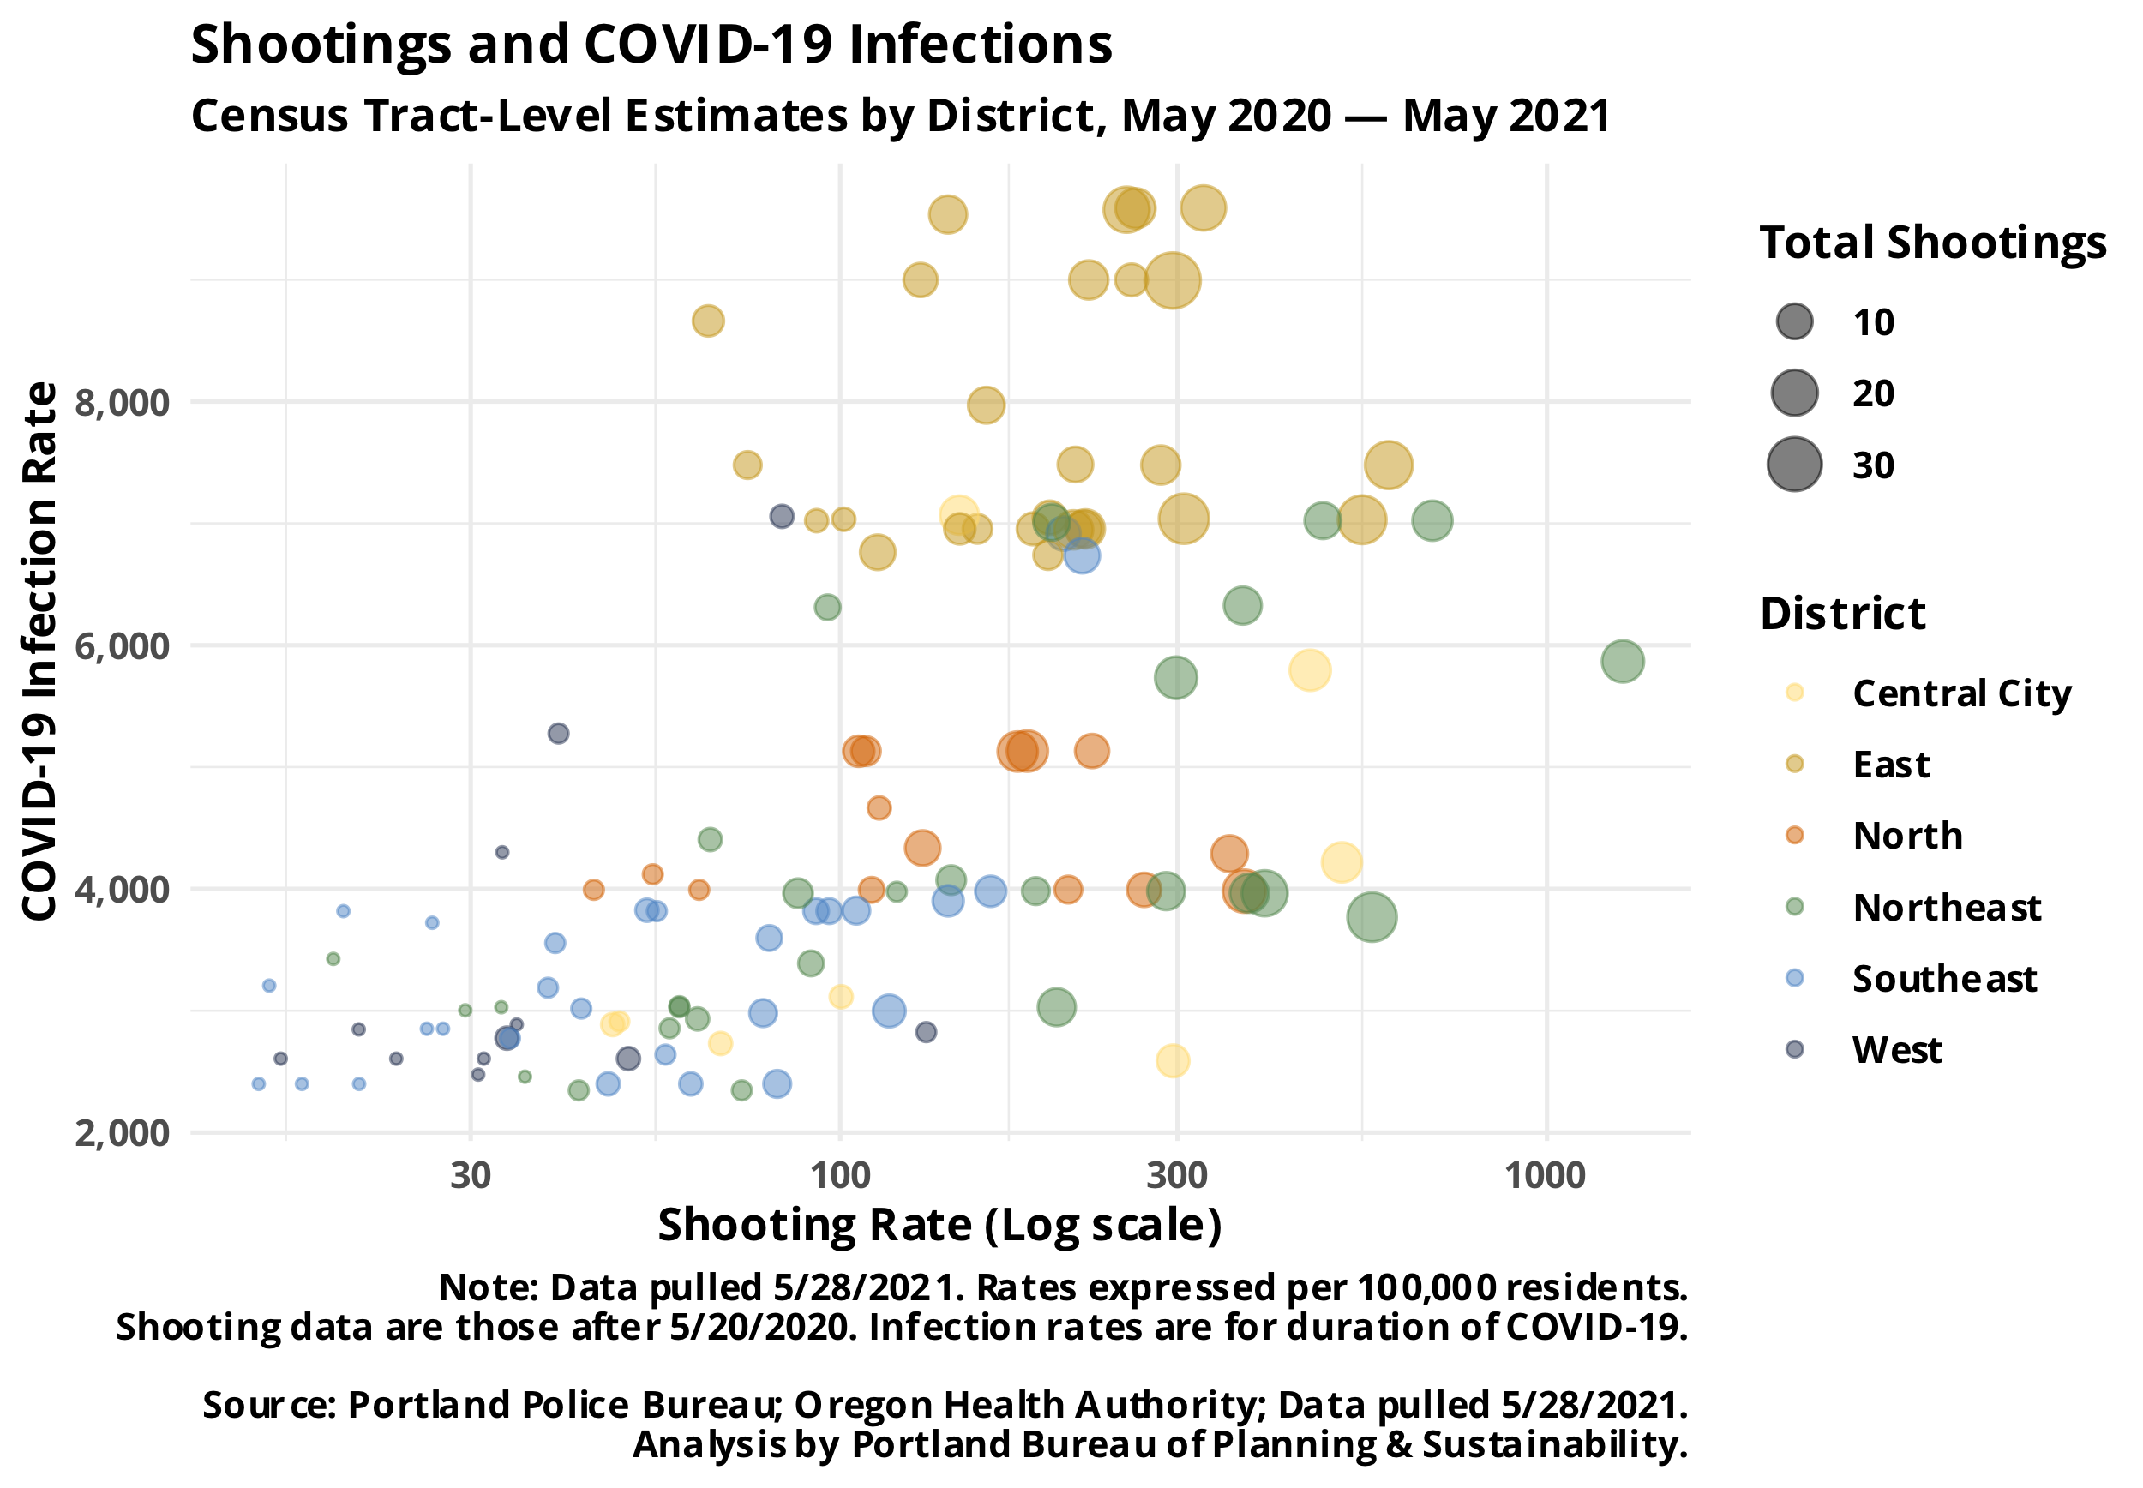
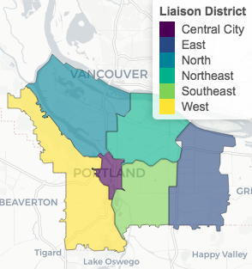
Medium but significant positive correlation
R² = 0.24 = “24% of the variation in shooting rates and COVID-19 infection rates can be explained by the linear relationship between the two”
Notes:
Takeaway: East Portland has high shooting rate, high total shootings and high COVID-19 infection rates.

Slide 13
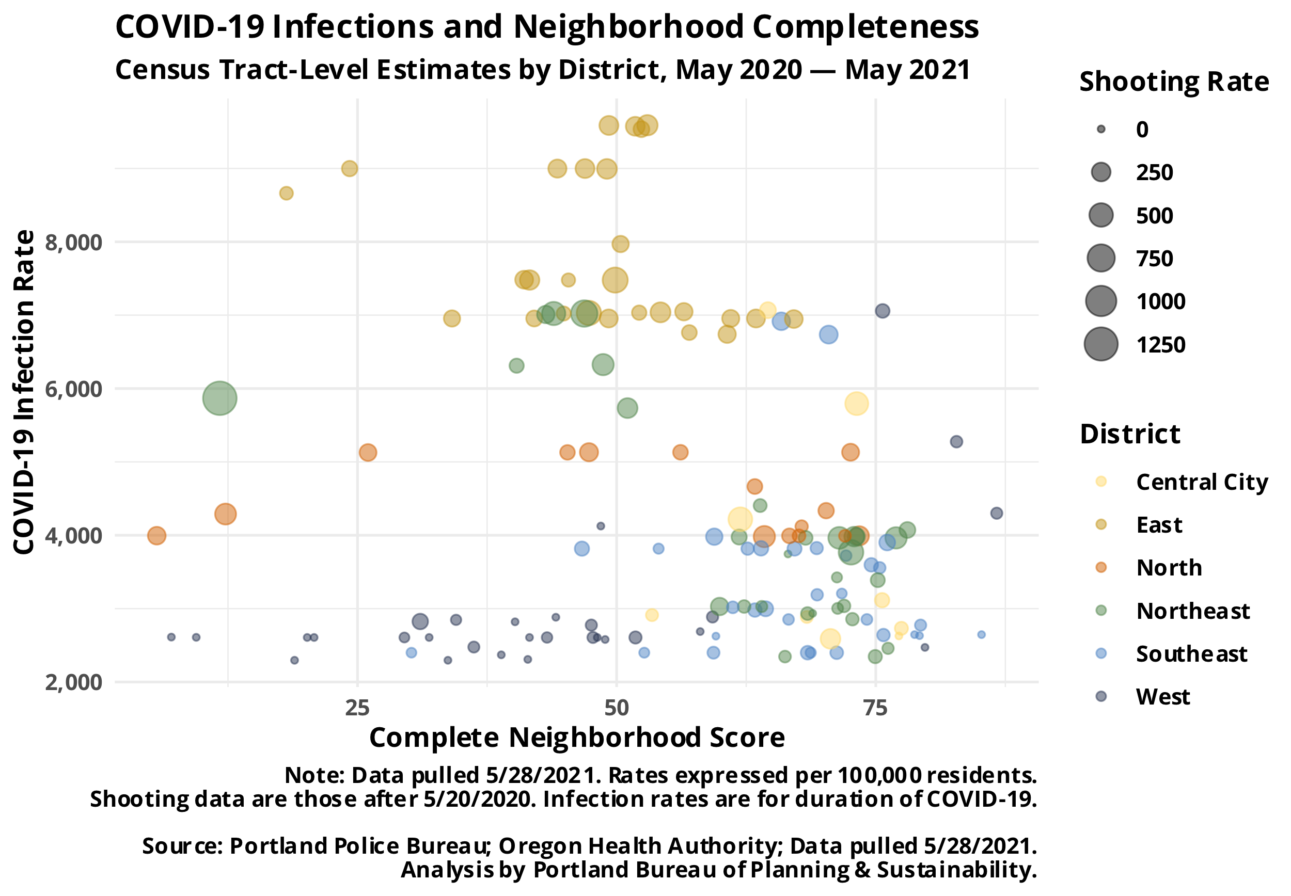
Weak but significant negative correlation
R² = 0.03 = “3% of the variation in complete neighborhood score and COVID-19 infection rates can be explained by the linear relationship between the two”
Notes:
Takeaway: Not a meaningful correlation between COVID-19 infections and neighborhood completeness

Slide 14
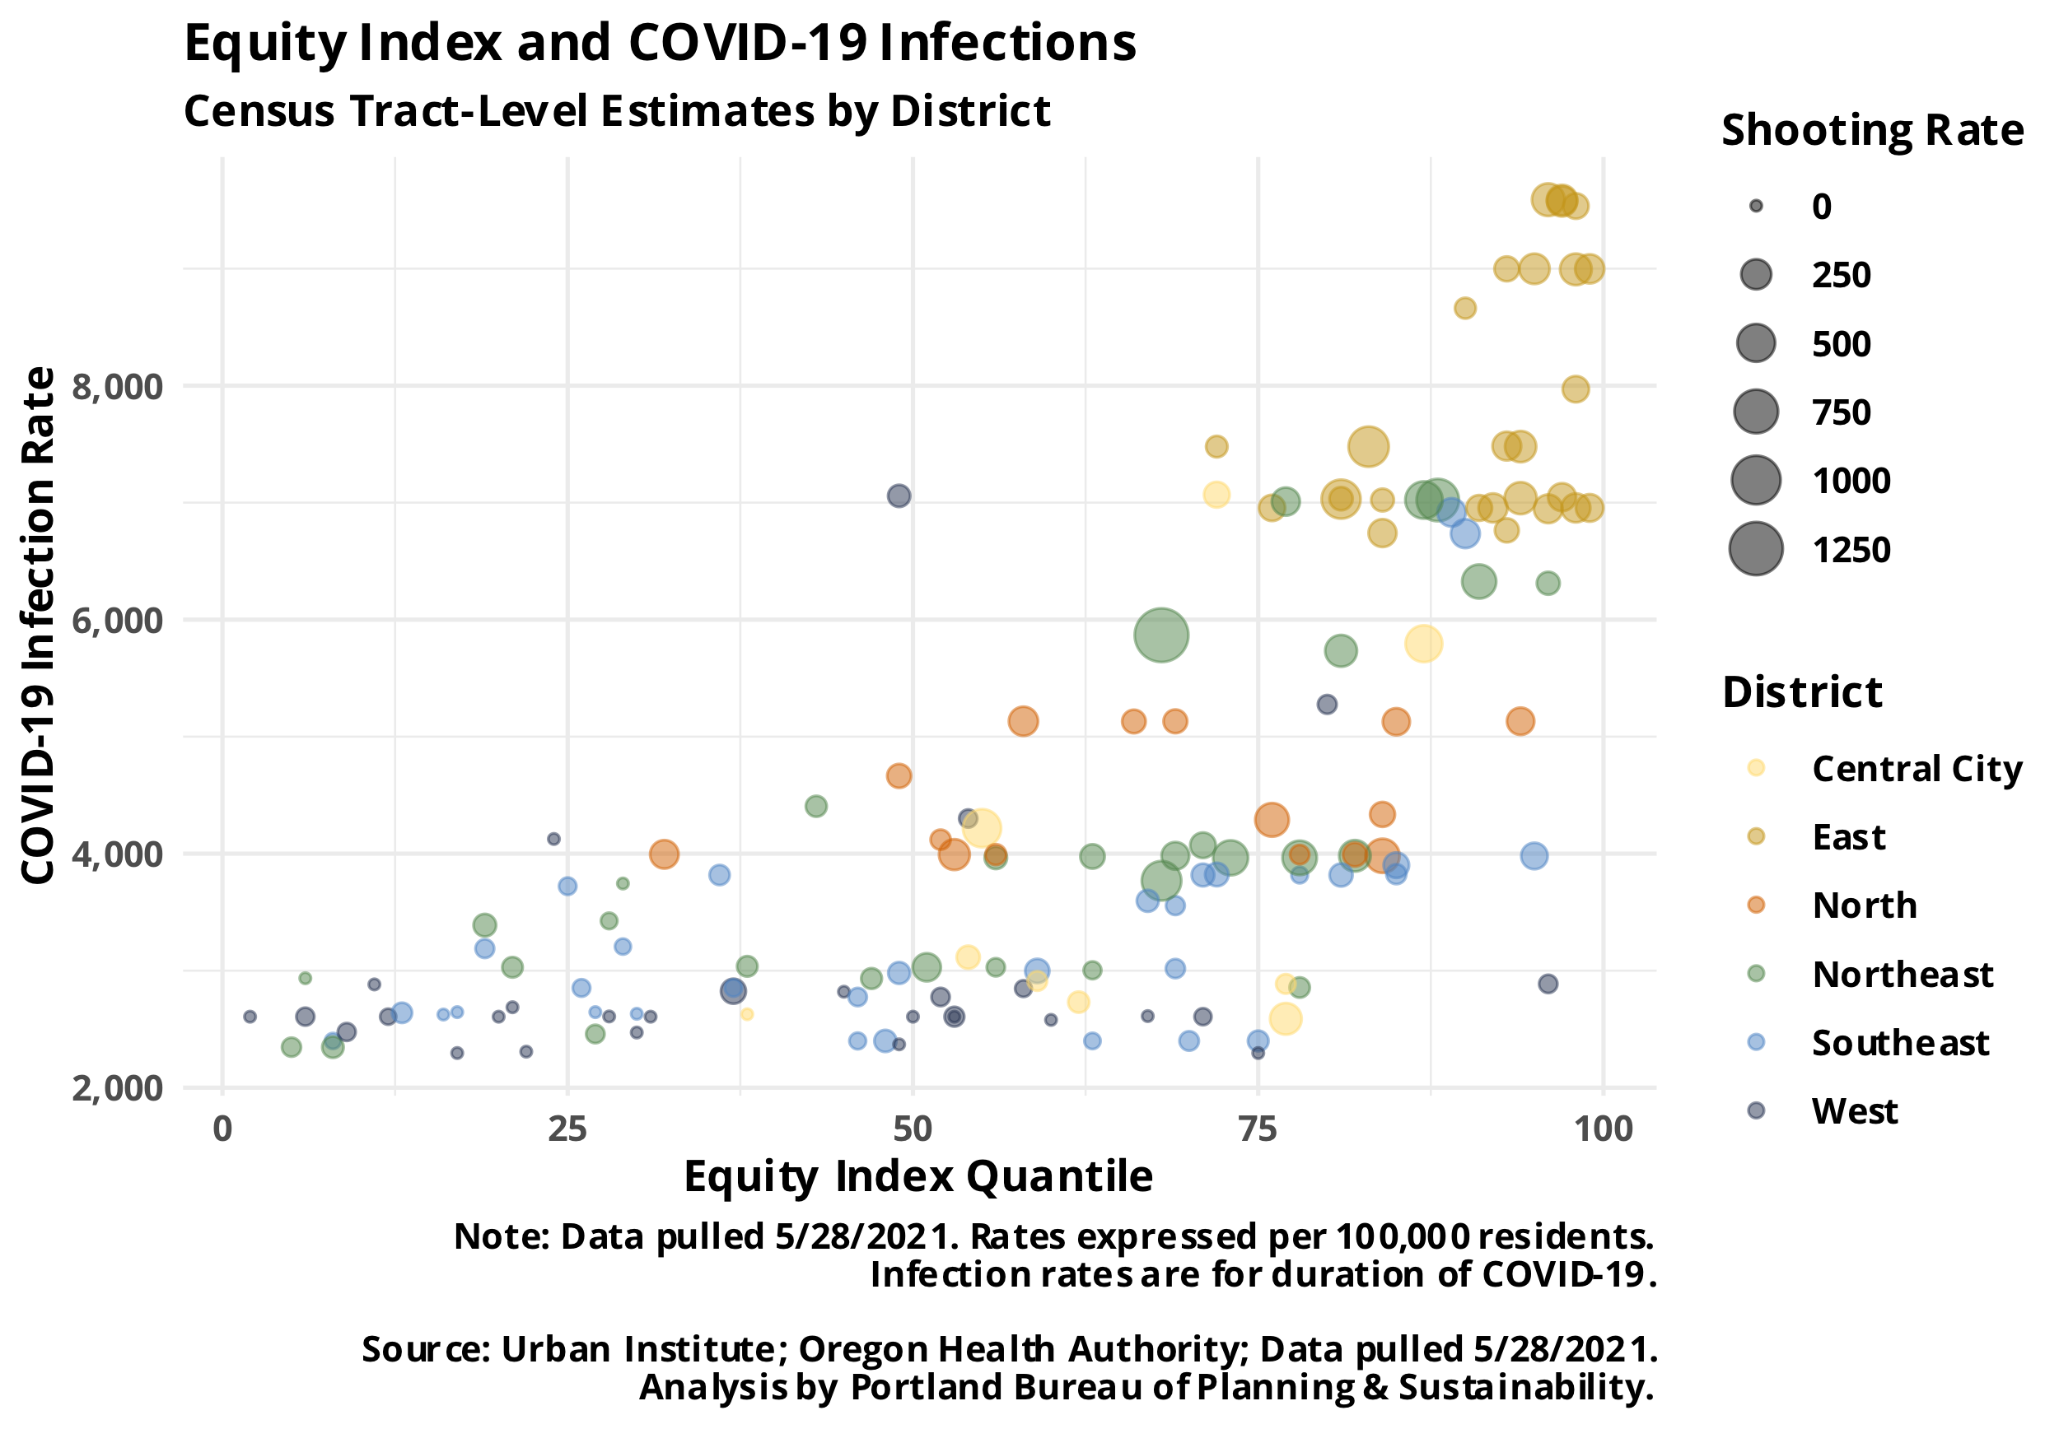
Medium but significant positive correlation
R² = 0.49 = “49% of the variation in equity index and COVID-19 infection rates can be explained by the linear relationship between the two”
Notes:
Takeaway: Significant, moderate correlation showing overlapping existing need as well as COVID-19 infection outcomes and impact
https://www.urban.org/sites/default/files/2021/04/02/where_to_prioritize_emergency_rental_assistance_to_keep_renters_in_their_homes_technical_appendix.pdf

Slide 15
Bivariate Maps

Slide 16
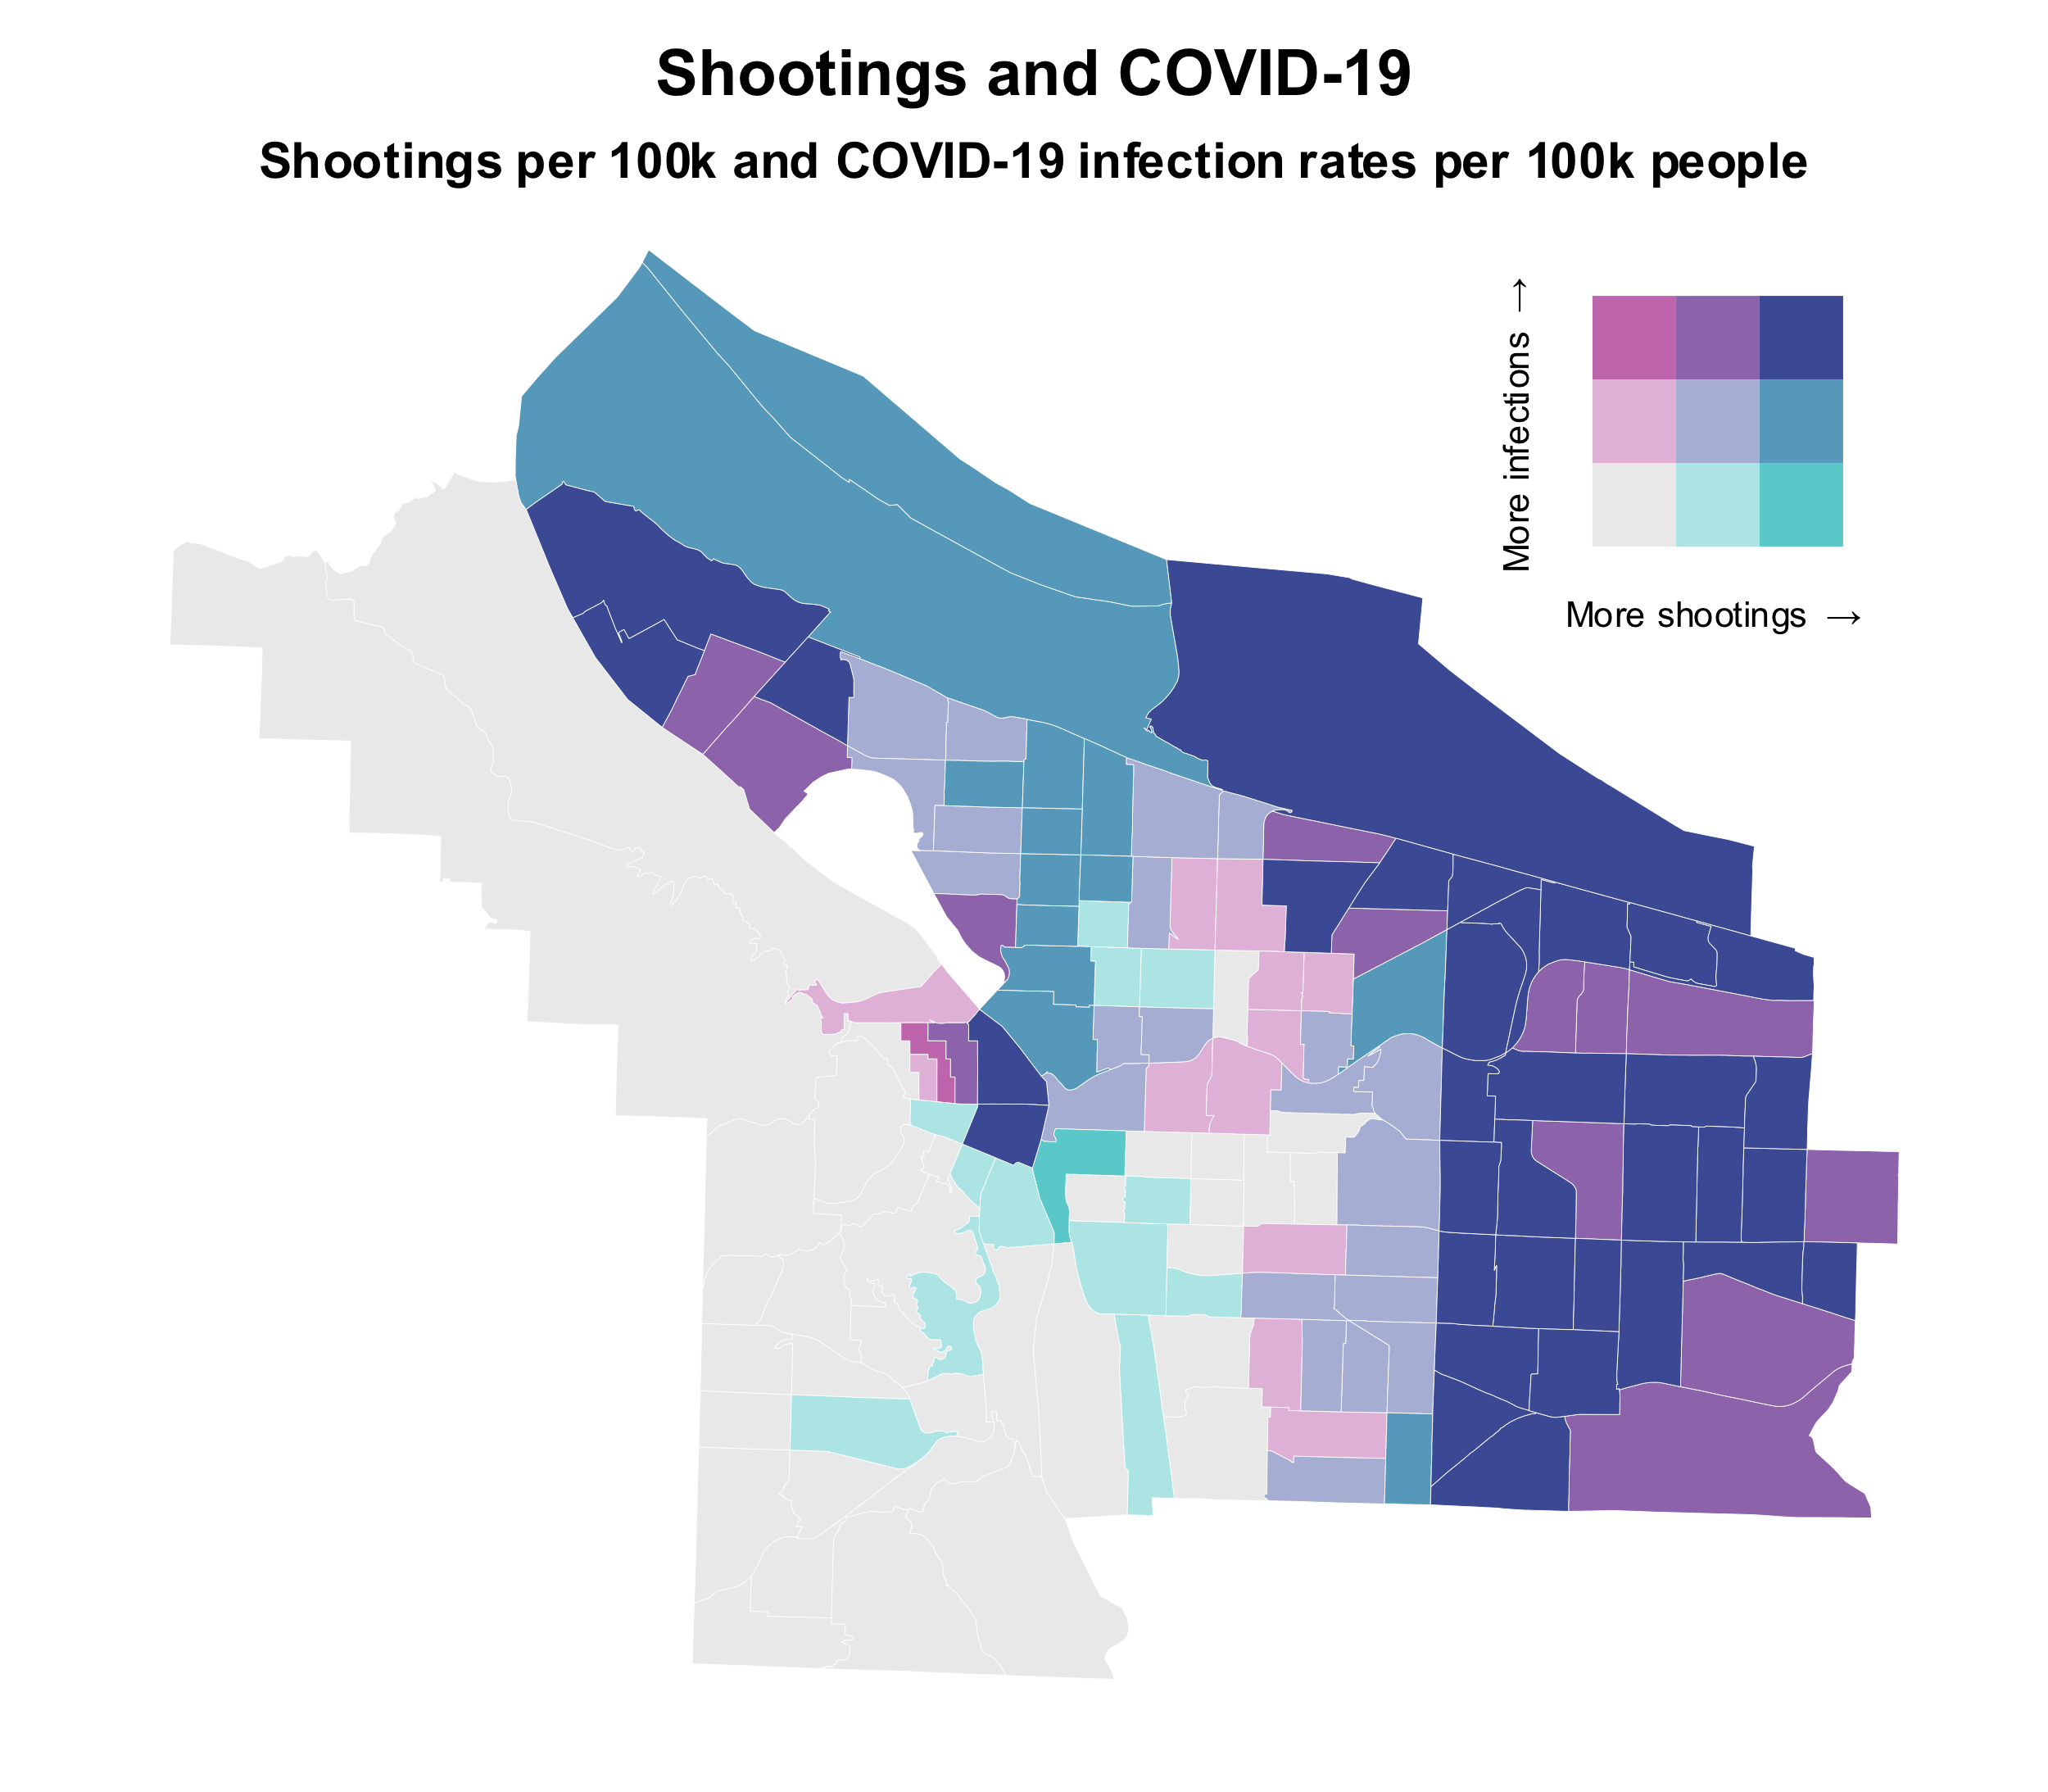

Shootings and Infections
More infections
More shootings
Fewer infections
More shootings
Notes:
Indigo
Teal
Fuchsia

Slide 17
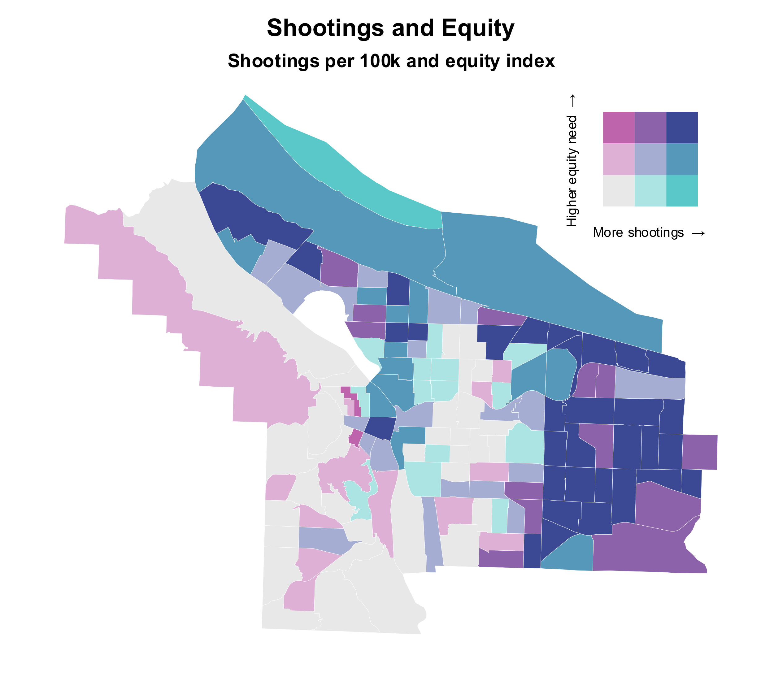
Shootings and Equity
Higher vulnerability
High shootings
Lower vulnerability
High shootings

Slide 18
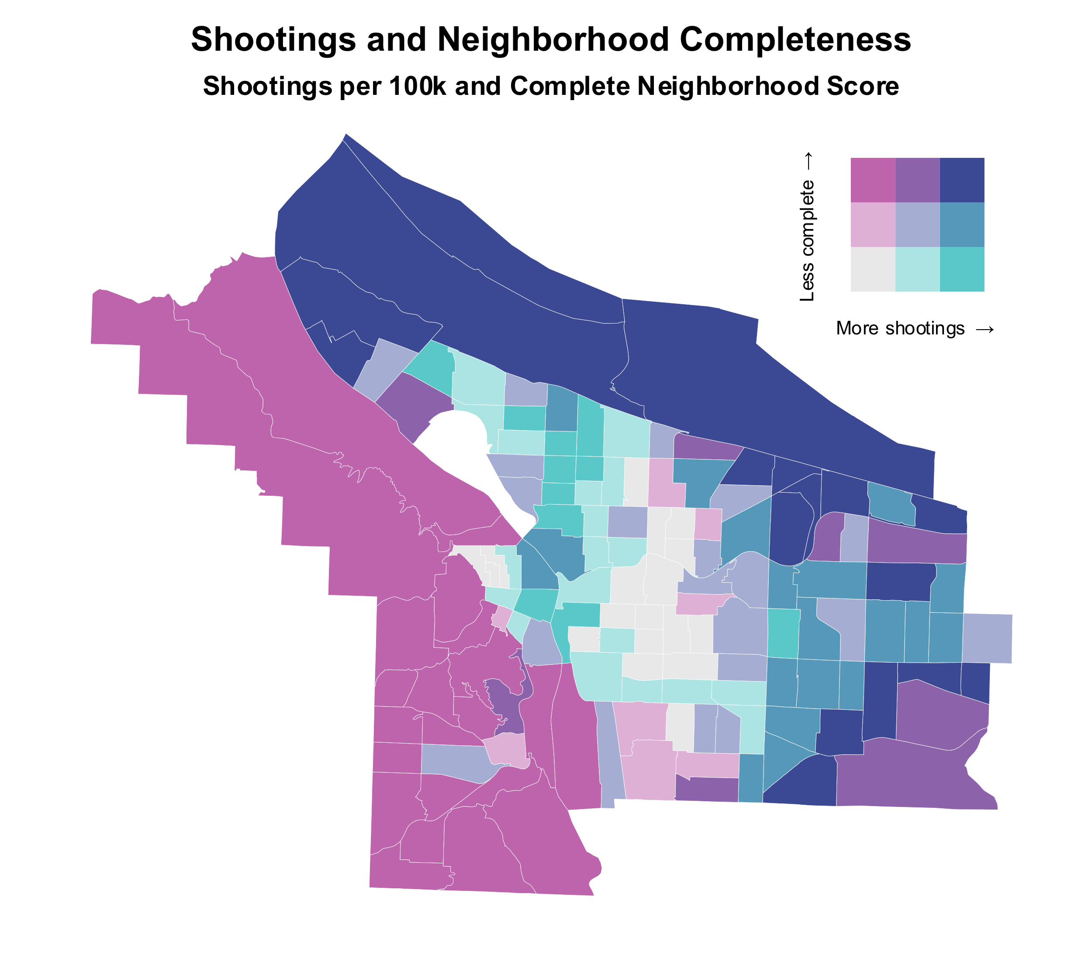
Shootings and Completeness
More incomplete
More shootings
More complete
More shootings

Slide 19
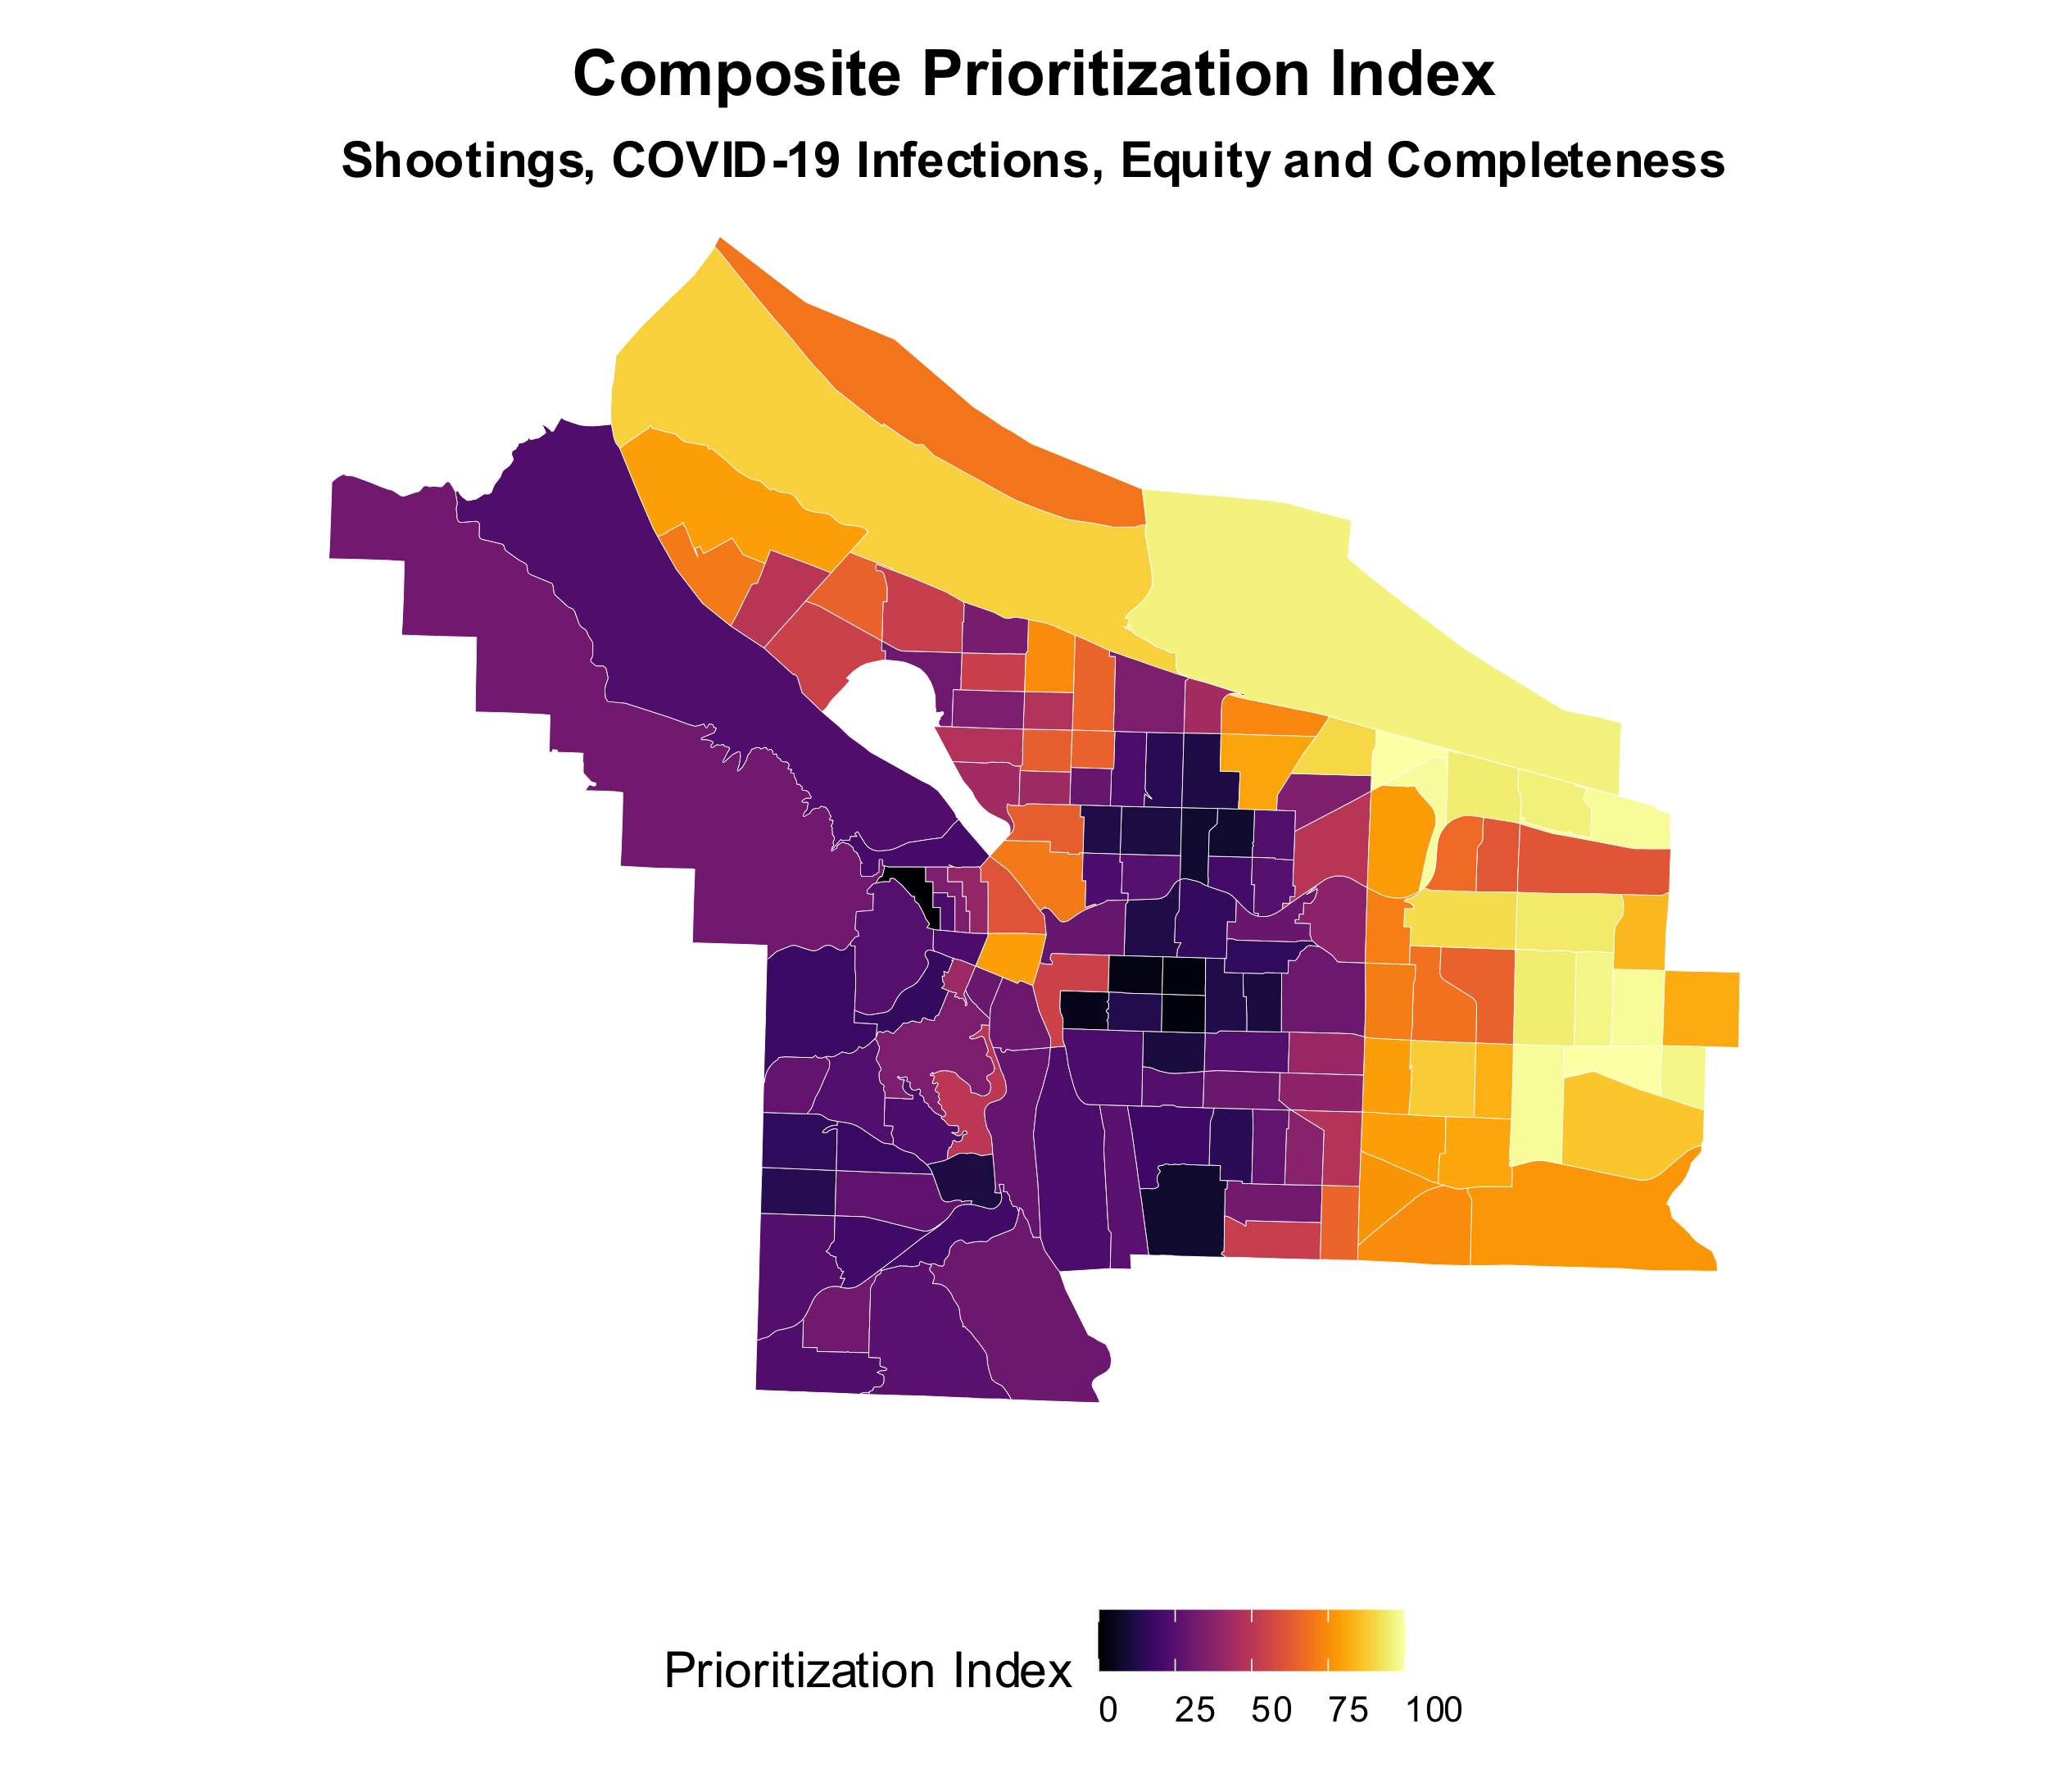
Prioritization Index
Shootings (weighted 2x)
COVID rates
Vulnerability
Incompleteness
Top Neighborhoods
Centennial
Sumner
Maywood Park
Powellhurst Gilbert
Wilkes
PDX-Marine Drive
Argay
Parkrose
Hazelwood
Cully

Slide 20
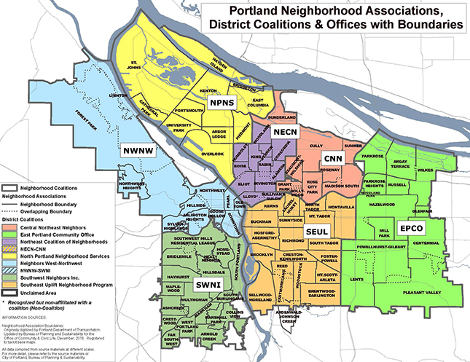

Slide 21
Caveats and future direction
Rigorous spatial statistical analysis is lacking due to time constraints
ZIP code-level COVID infection rates → Areal weighting applied to estimate tract-level rates
PPB jurisdiction doesn’t align to tracts → Edge tracts have analytical inaccuracies
Notes:
Did not look at XY coordinates of shootings and taking into consideration boundary effects

Slide 22
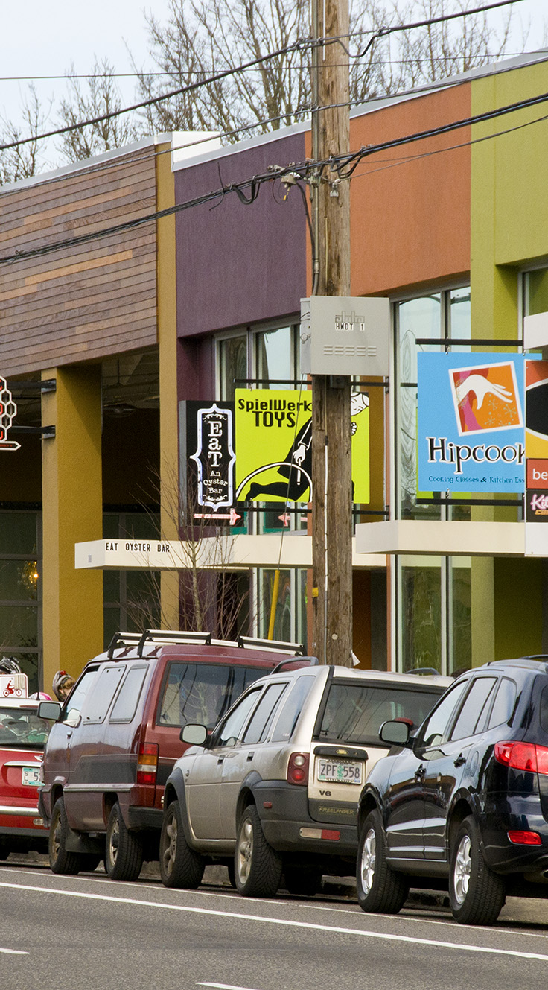
Nick Kobel
Analyst

Slide 24
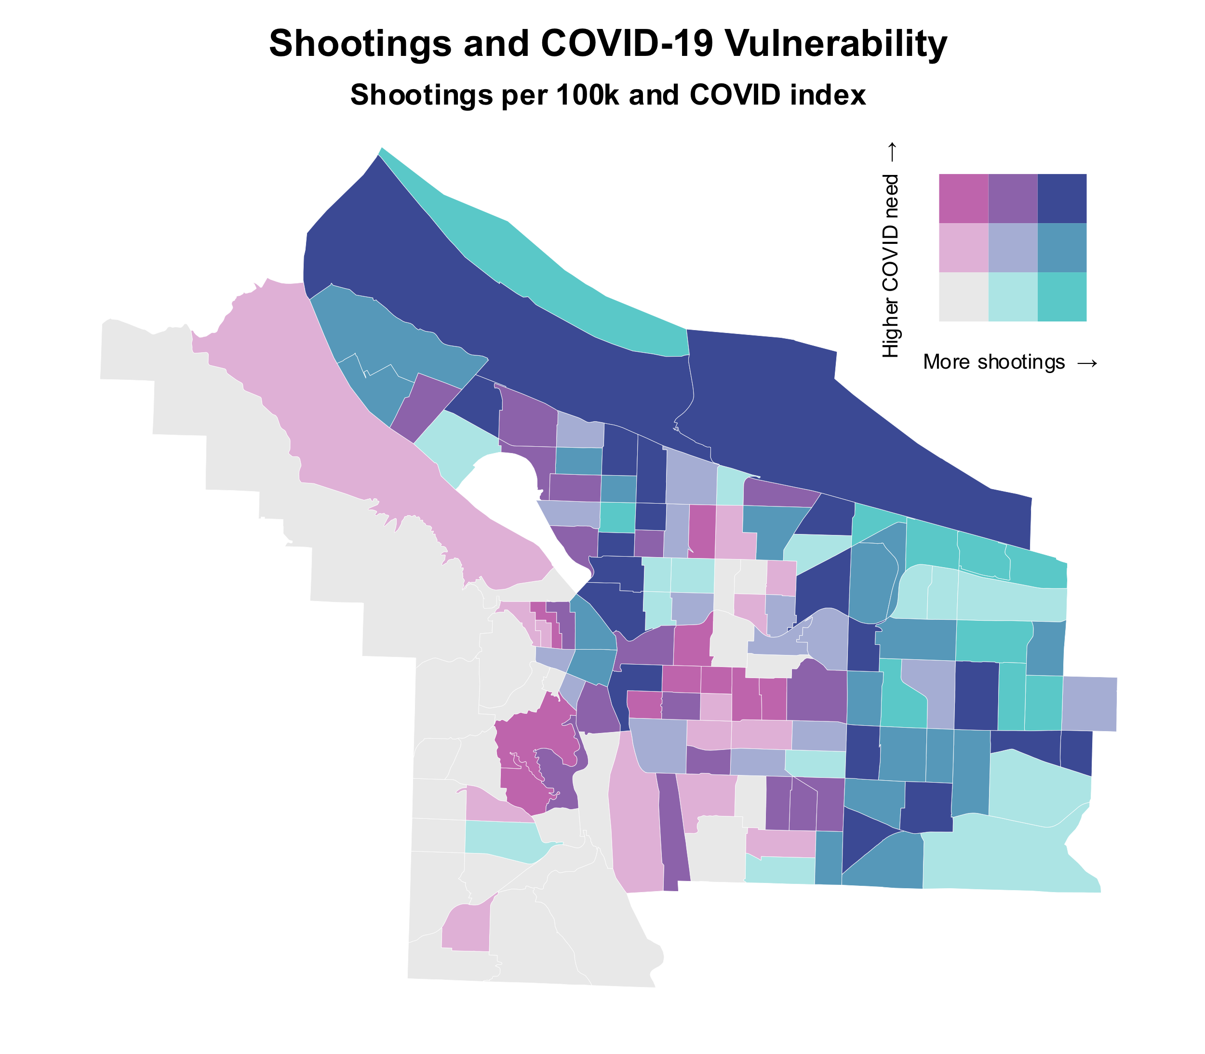

Slide 25
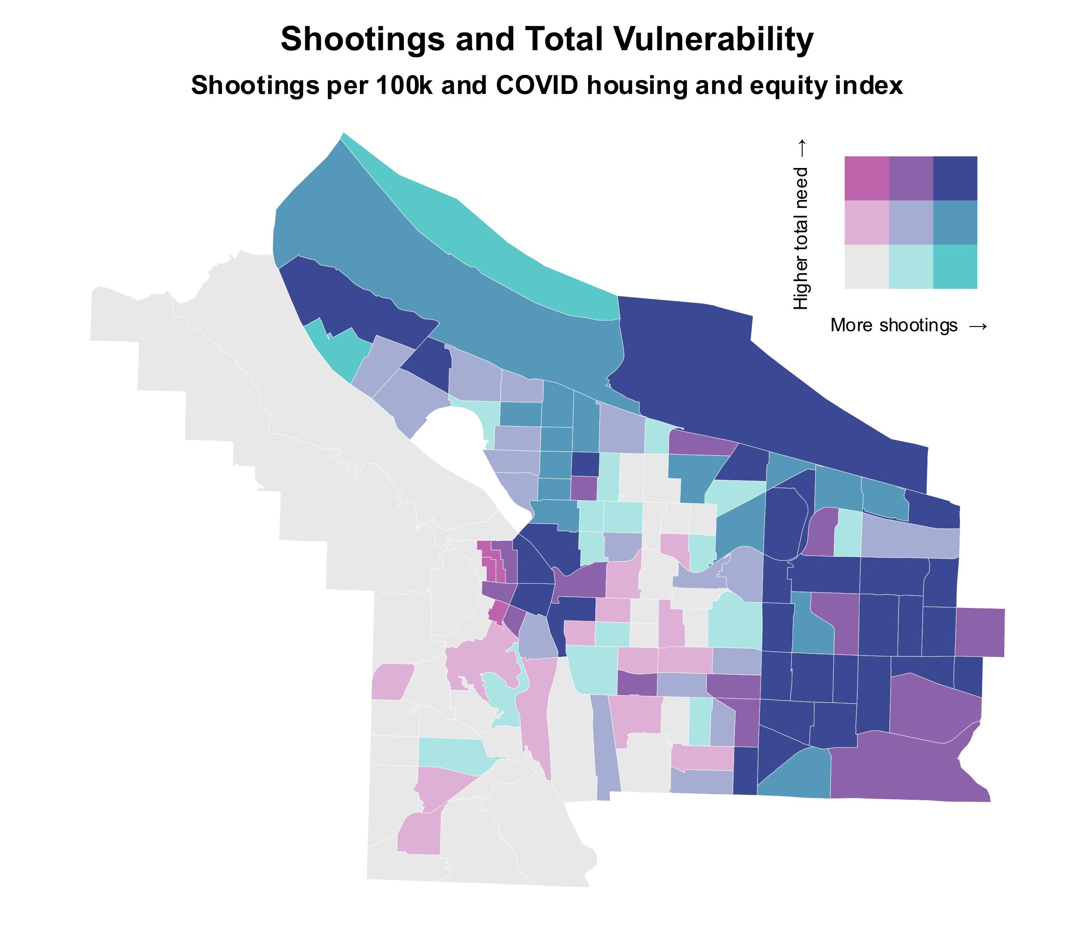

Slide 26
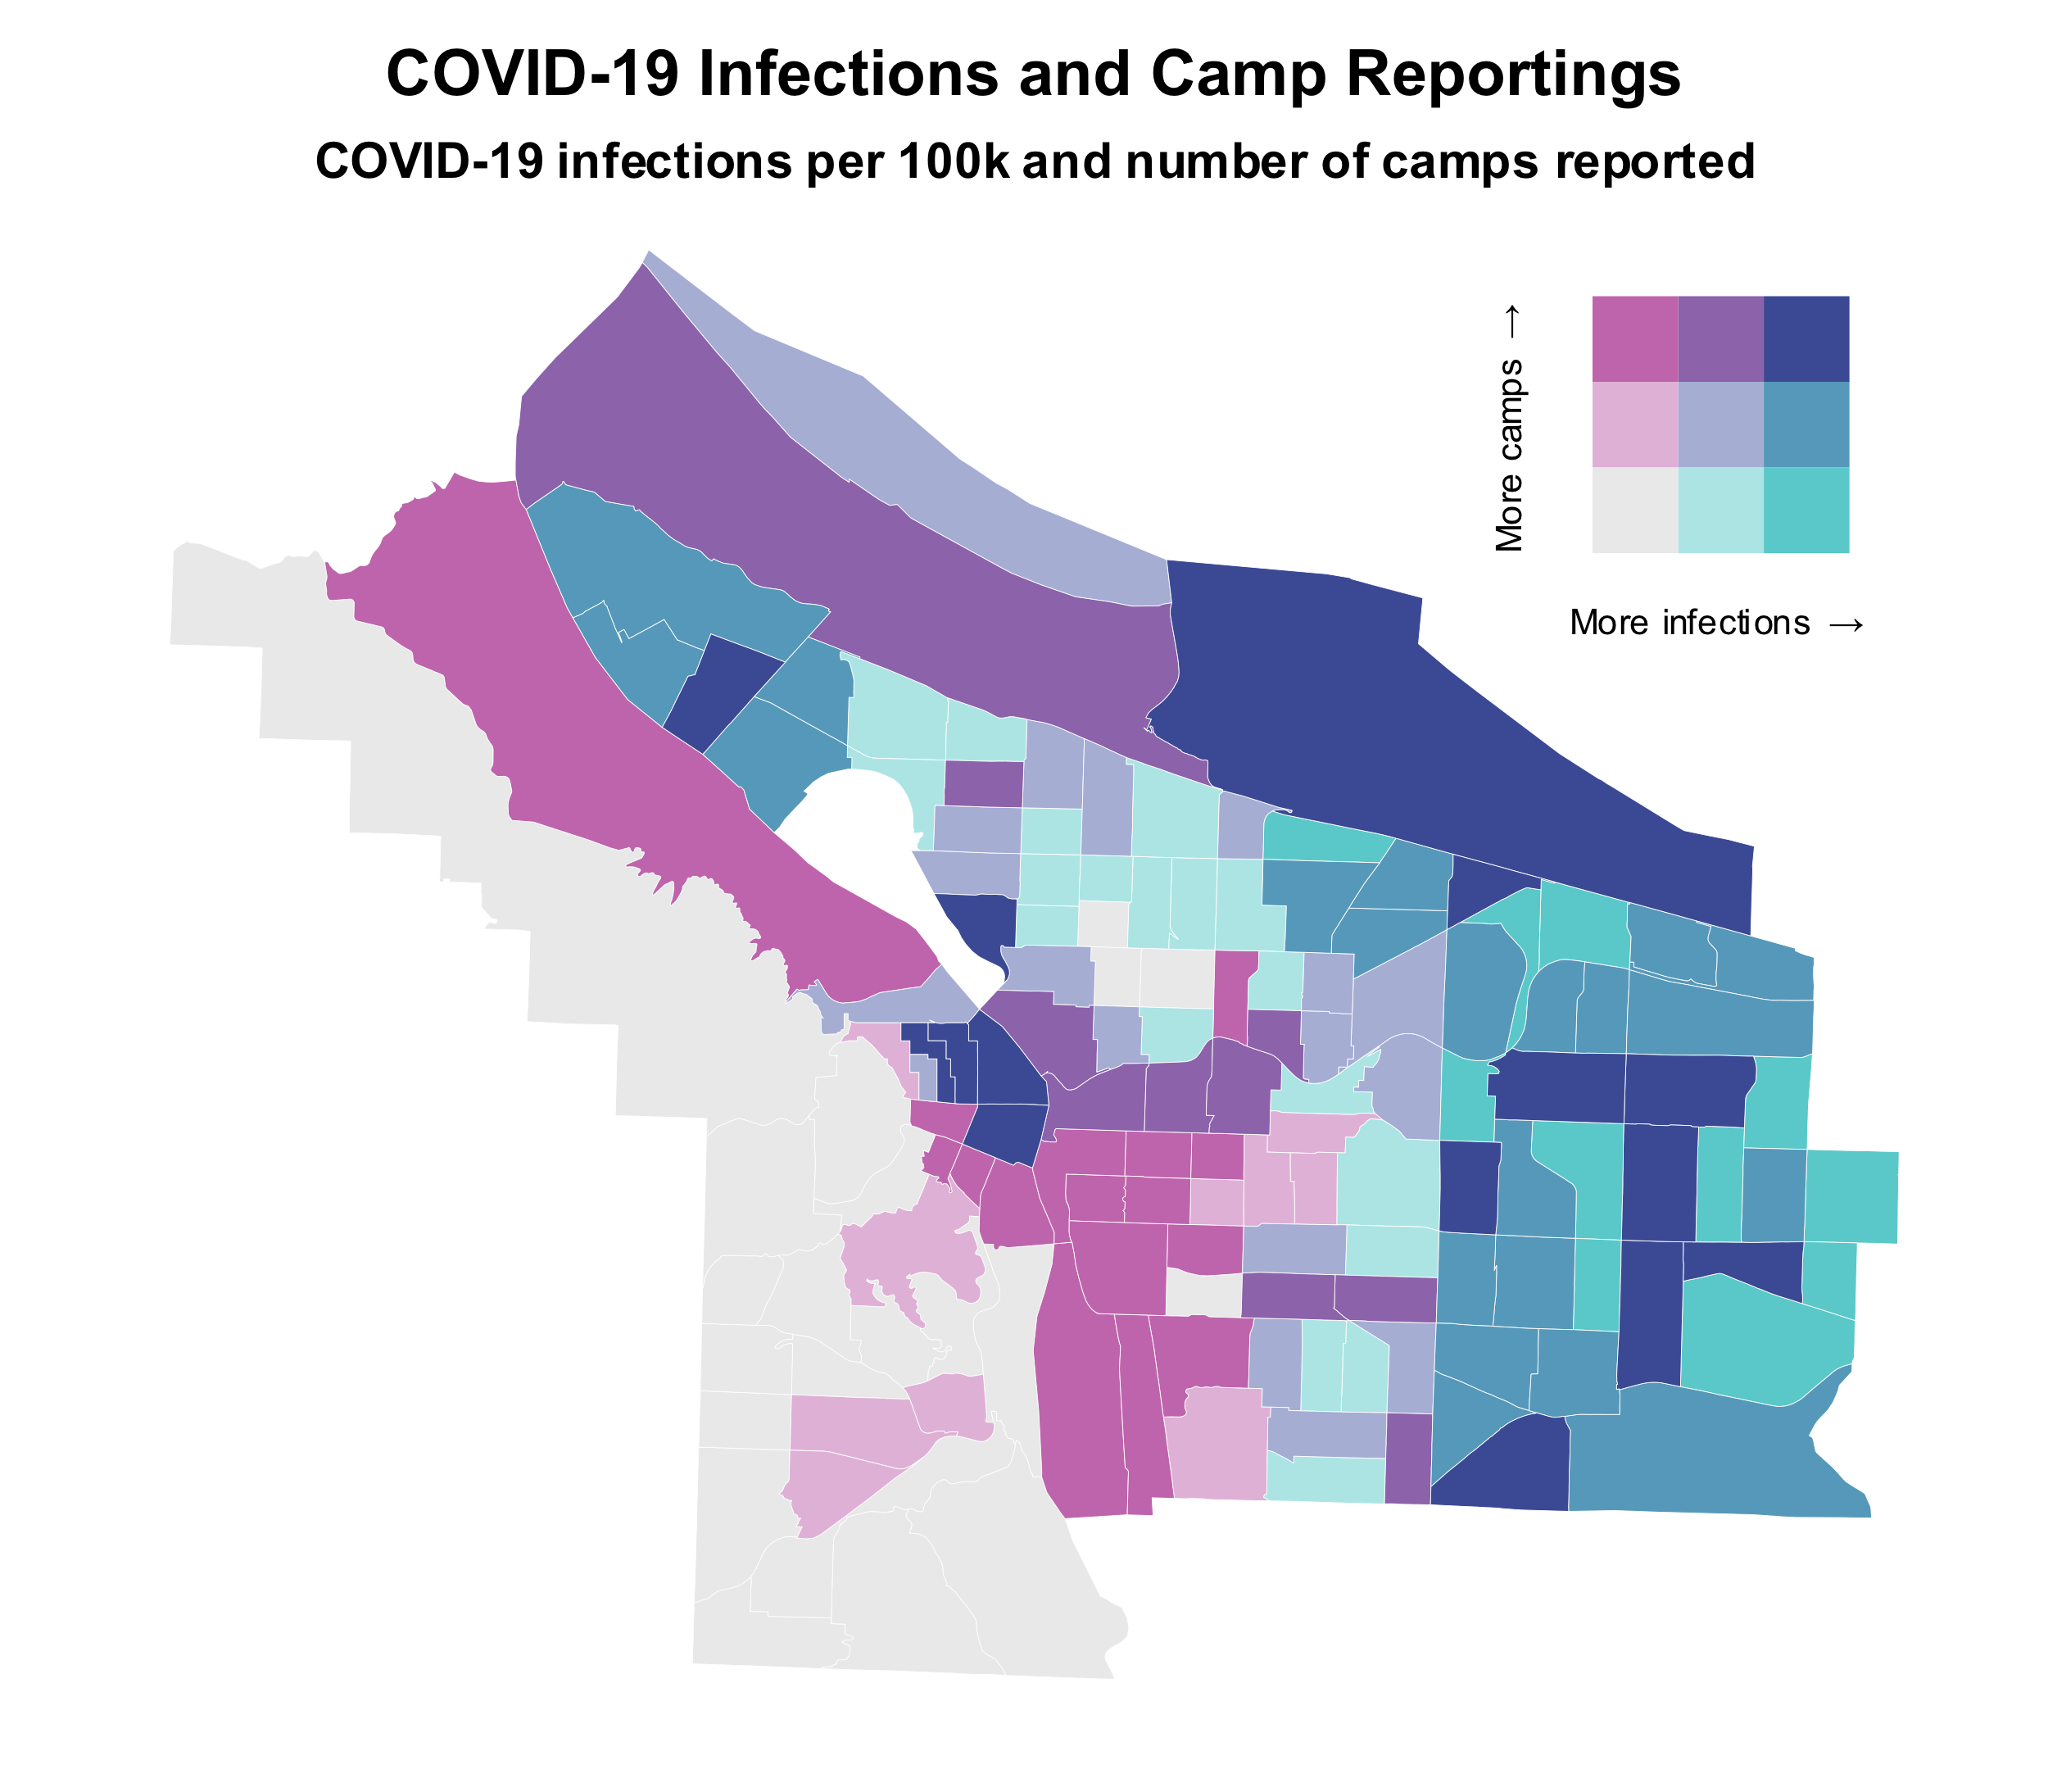

Slide 27
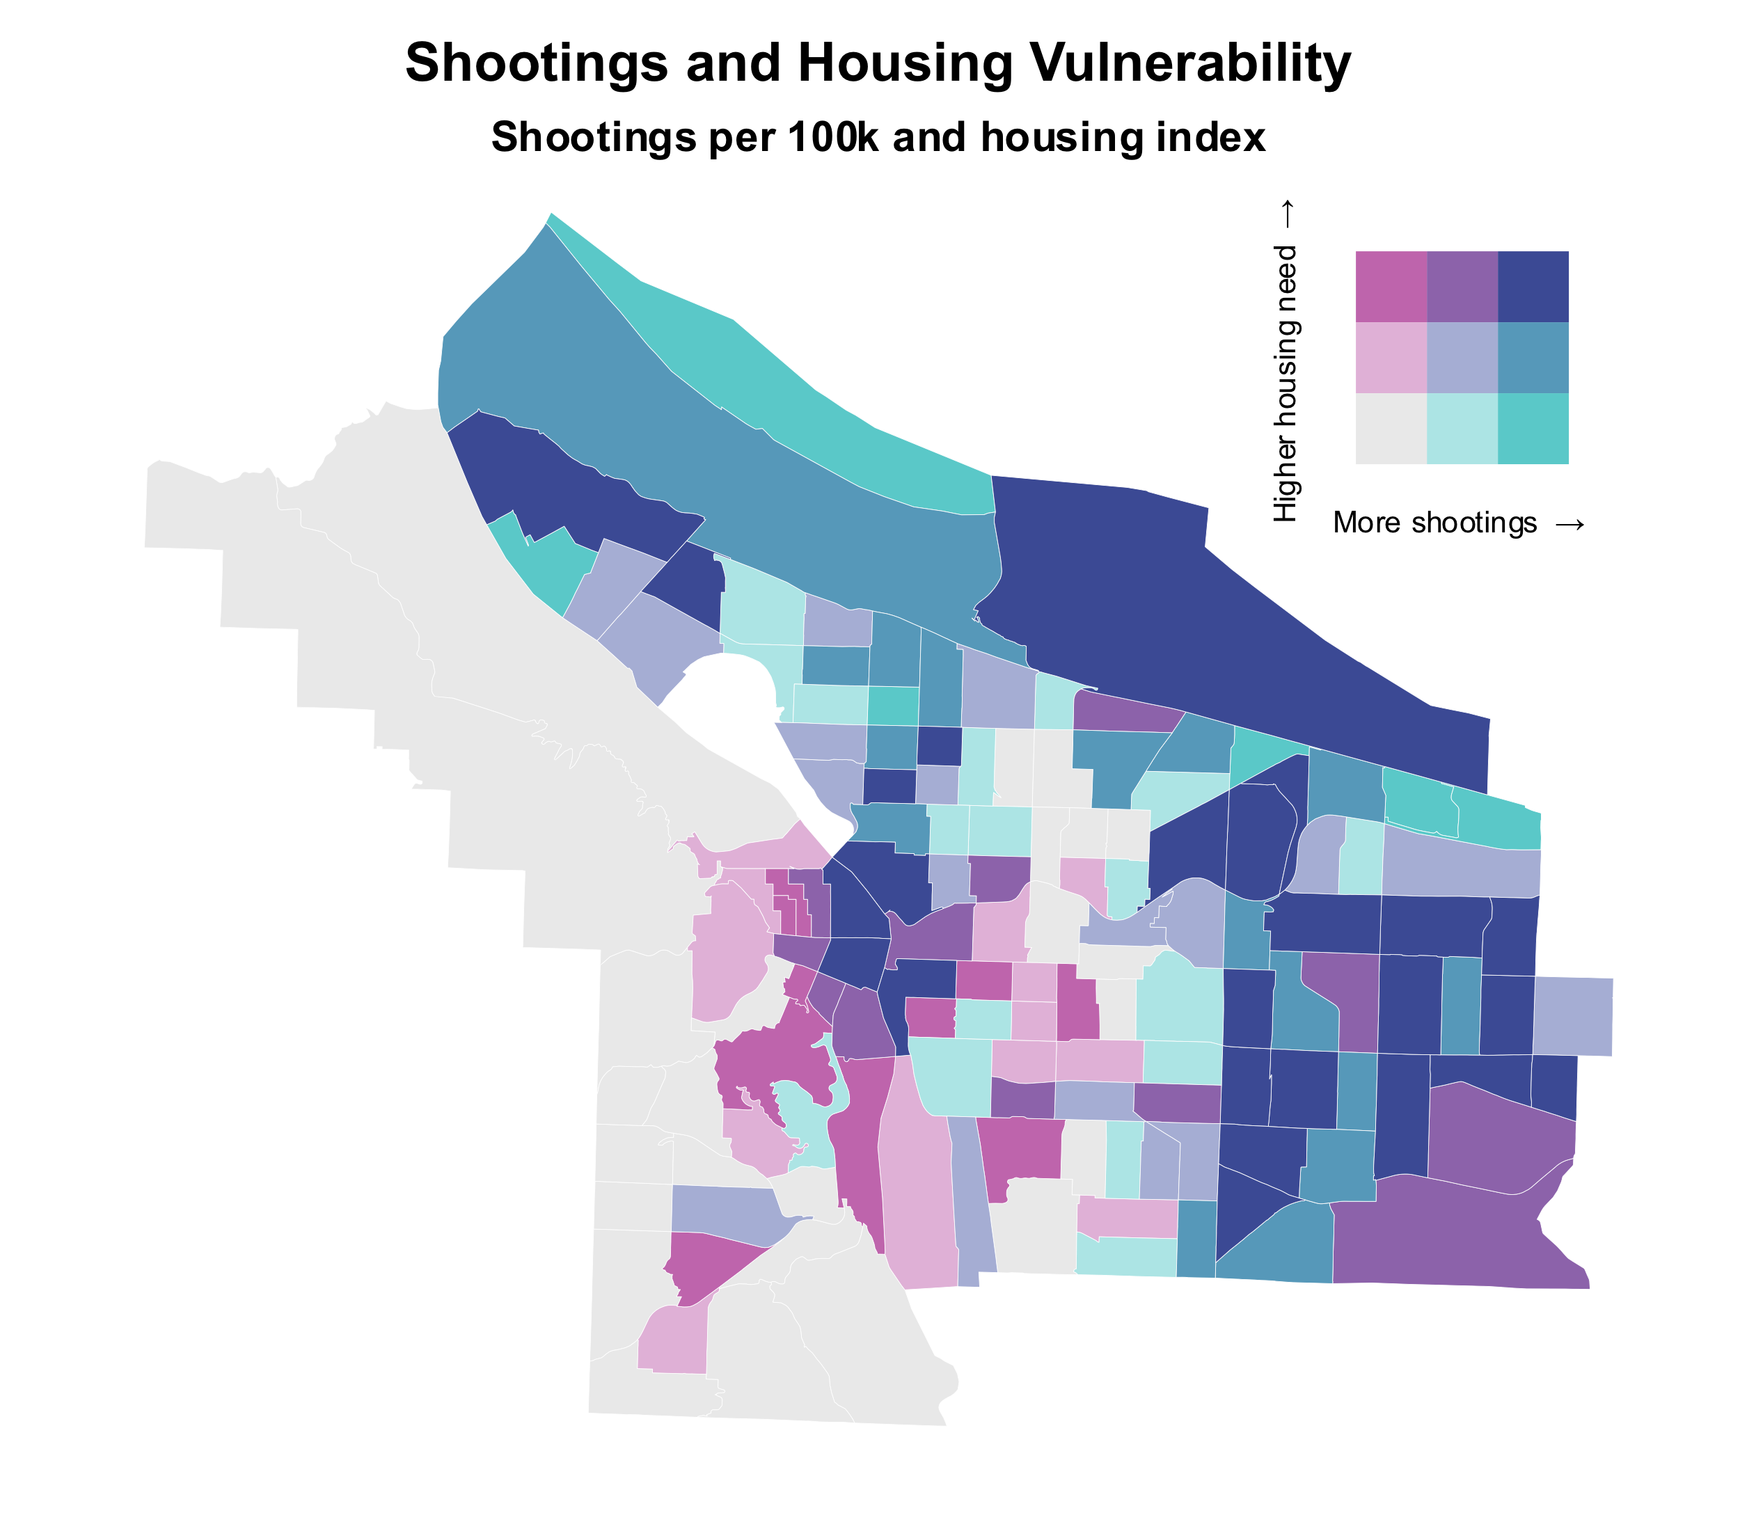

Slide 28
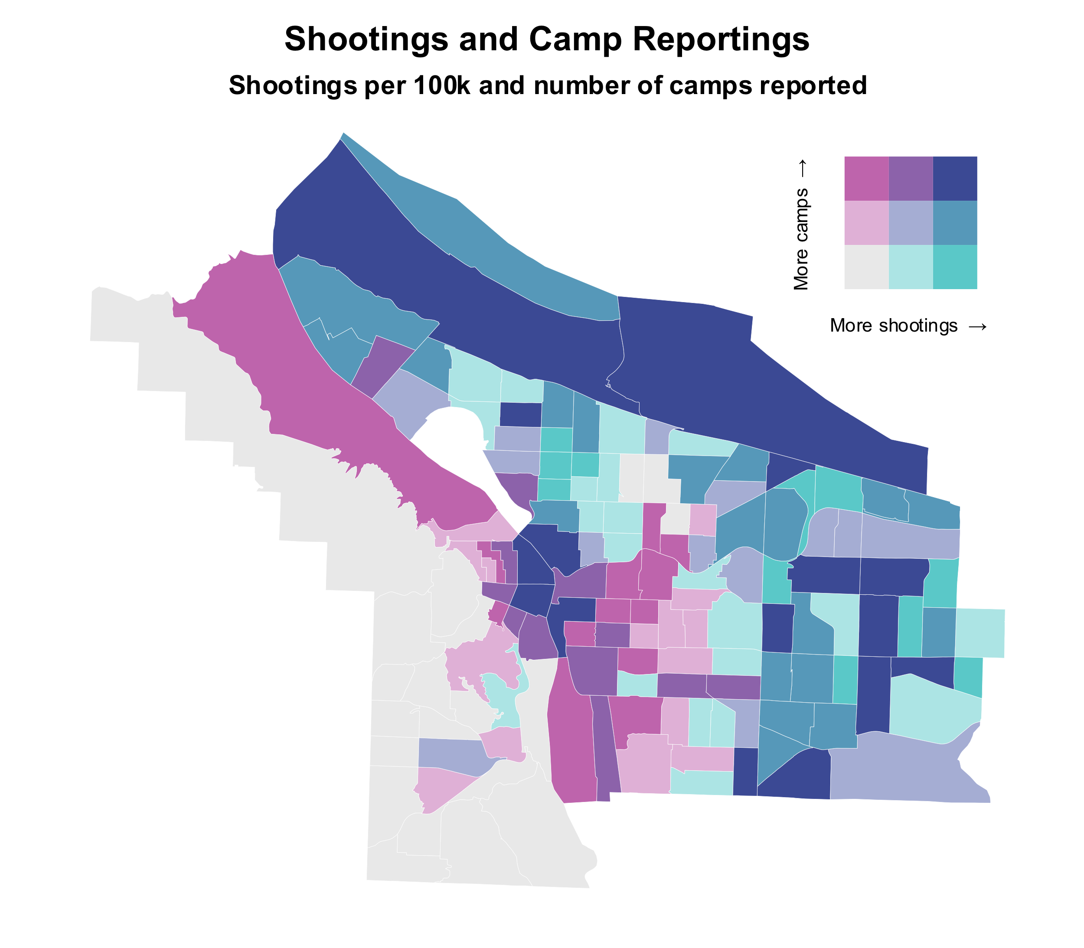

Slide 31
Neighborhood | Priority Index | Shooting Rate | COVID Rate | Equity Index | CN Score
Centennial | 100 | 225 | 8,998 | 99 | 44
Sumner | 100 | 689 | 7,022 | 88 | 47
Maywood Park | 99 | 482 | 7,022 | 87 | 44
Powellhurst Gilbert | 99 | 295 | 8,994 | 98 | 49
Wilkes | 99 | 284 | 7,479 | 94 | 42
PDX-Marine Drive | 96 | 1,281 | 5,867 | 68 | 12
Argay | 96 | 597 | 7,478 | 83 | 50
Parkrose | 95 | 548 | 7,030 | 81 | 47
Hazelwood | 95 | 254 | 9,575 | 97 | 52
Cully | 90 | 371 | 6,326 | 91 | 49

Slide 32
